Slide 1
Obesity in the United Kingdom
Student Number #XXXXX
Title Introduction to the studying skills
Module Name/Code code3HW002
Module leader XXXX XXXXX
Date 14/01/2022

Slide 2
Overview
This presentation will cover:
Causes of obesity in the UK
Effects of obesity in the UK
Managing obesity in the UK
Obesity statistics in the UK
Notes:
This presentation will shed light on the following: the causes of obesity in the UK, the effects, the statistics, and managing obesity.

Slide 3
Causes of Obesity in the UK
Uncontrolled junk food consumption
Lack of adequate exercising
Genetics
Sedentary lifestyles (Bridger 2019).
Poor diet
Notes:
Obesity in the UK is caused by a number of factors. First, the cases of obesity are as a result of uncontrolled junk eating of fast foods that are rich in cholesterol. The lack of sufficient exercises also increase the prevalence to obesity among the UK communities. Also, obesity is a result of inherited genes. Most profoundly, obesity is caused by the sedentary lifestyles that is embraced by both children and adults in the United Kingdom. Poor diets in homes as well as institutions like schools have led to increased cases of obesity.

Slide 4
Effects of Obesity in the UK
Increased risks of other health conditions like hypertension, Type II Diabetes, and deep vein thrombosis (Zimdars 2019).
Poor work or school productivity
Increased obesity care budget that strains the economy
Reduced mobility among the obese people
Notes:
Obesity increases the prevalence to other diseases like hypertension, Type II diabetes, deep vein thrombosis among other ailments. Also, people with obesity have a relatively low productivity potential at work or in school as compared to other healthy individuals. In the UK, the government has allocated more money to help cater for obesity patients, something that has strained the national treasury. People with obesity also struggle with mobility as some are moved by fire fighters in time of emergencies.

Slide 5
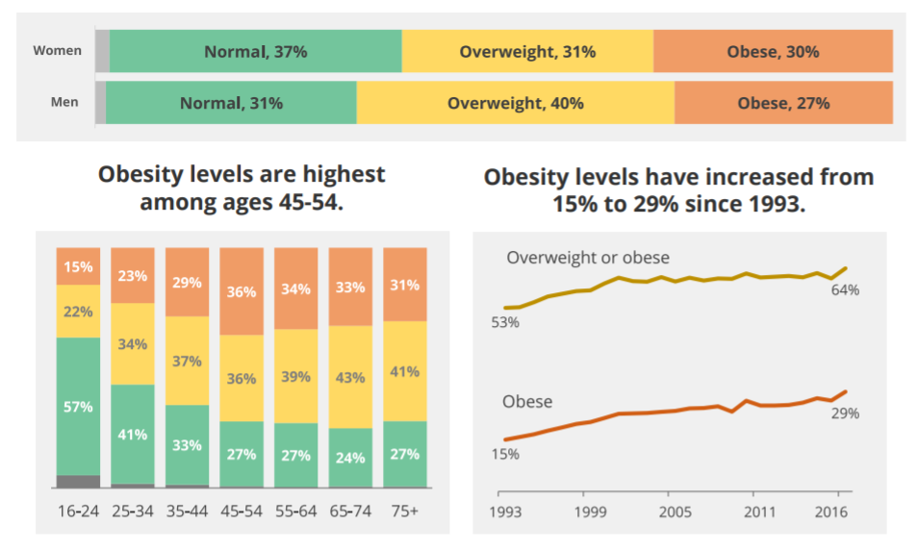
Obesity statistics in the UK
Source: (Baker 2019)
Notes:
People within the 45 to 54 age group have the highest cases of obesity. Since 1993, the cases of obesity in the UK have seen a substantial increase from 15% to 29%. Noteworthy, men are more likely to be obese as compared to women in the UK.

Slide 6
Managing Obesity in the UK
Introducing healthier diets in institutions and work places
Ban the promotion and advertisement of high-cholesterol foods (Aronne & Kumar 2019).
Promote visible warning on foods that contain high cholesterol levels
Promote a healthy lifestyle among the citizenry
Notes:
Obesity can be managed in the UK by embracing the following measures: Introducing healthier diets in institutions and work places, banning the promotion and advertisement of high-cholesterol foods, promoting visible warning on foods that contain high cholesterol levels, and promoting a healthy lifestyle among the citizenry

Slide 7
Reference List
Aronne, L. J., & Kumar, R. B. (2019). Obesity management : a clinical casebook. Cham: Springer.
Baker, C. (2019). Obesity Statistics. London: House of Commons Library.
Bridger, R. S. (2019). A guide to active working in the modern office : homo sedens in the 21st century. Boca Ranton: CRC Press.
Zimdars, M. (2019). Watching our weights : the contradictions of televising fatness in the "obesity epidemic". New Brunswick: Rutgers University Press.

Slide 8
Notes:
https://www.ozessay.com.au

